Slide 1
Introduction to Simulation and Modeling
Azaz Ahmed Kiani

Slide 2
Input Data Collection and Analysis
(Common Input Data Distributions)
(Lecture 16)

Slide 3
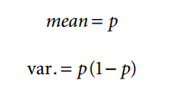
Bernoulli Distribution
The Bernoulli distribution is used to model a random occurrence with one of two possible outcomes.
These are frequently referred to as a success or failure. The mean and variance of the Bernoulli distribution are:
where p = the fraction of successes and (1 − p) = the fraction of failures

Slide 4
Bernoulli Distribution
Examples of the Bernoulli distribution in simulation can be found in:
• Pass/fail inspection processes
• First-class vs. coach passengers
• Rush vs. regular priority orders
In the case of pass vs. fail inspection processes, the part can be only one of these two states.
If 95% of the parts successfully pass the inspection, then the pvalue would be 0.95.
The 5% failure rate would be represented by 0.05

Slide 5
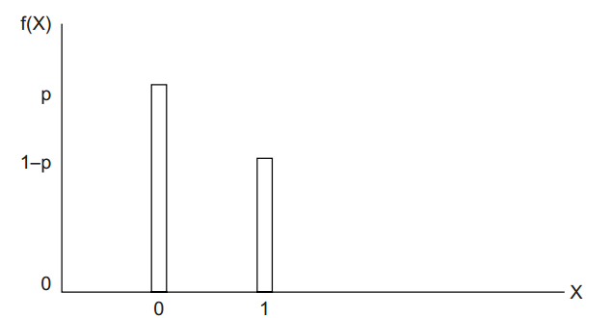
Bernoulli Distribution

Slide 6
Uniform Distribution
A uniform distribution means that over the range of possible values, each individual value is equally likely to be observed.
The common example of a uniform distribution is the behavior of a single six sided die.
The minimum possible value is 1 and the maximum possible value is 6.
Because all of the sides are the same, there is an equal probability of receiving any of the values between 1 and 6.

Slide 7
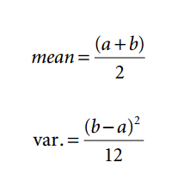
Uniform Distribution
For the statistically inclined, the formulas for the mean and variance of a uniform distribution are:
where a is the minimum value and b is the maximum v

Slide 8
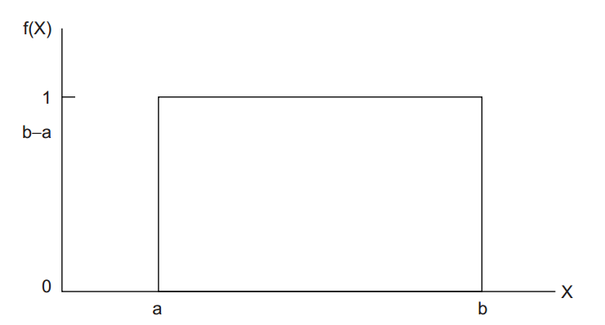
Uniform Distribution

Slide 9
Exponential Distribution
The exponential distribution is commonly utilized in conjunction with inter-arrival processes in simulation models because the arrival of entities in many systems has been either proven or assumed to be a random.
Even though the process is random, there will still be some average number of arrivals within the unit of time.
The number of arrivals that can be expected to arrive during the unit of time is randomly distributed around the average value

Slide 10
Exponential Distribution
When a system exhibits a random distribution for the number of arrivals for a given period of time, the time between the arrivals turns out to be exponentially distributed.
As we know, the time between the arrivals is known as the interarrival time.
The exponential distribution has only a single parameter. This value is the mean of the data set.
If the interarrival time does exhibit an exponential distribution, there will be a greater number of observations with interarrival times less than the mean value.
There will also be fewer observations with interarrival times greater than the mean value. Thus, the number of observations continuously decreases as the interarrival time increases.

Slide 11
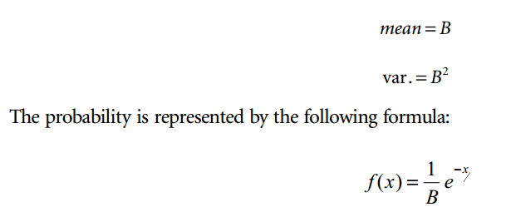
Exponential Distribution
where B is the average of the data sample and x is the data value

Slide 12
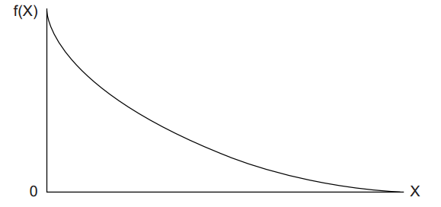
Exponential Distribution

Slide 13
Triangular Distribution
The triangular distribution may be used in situations where the practitioner does not have complete knowledge of the system but suspects that the data are not uniformly distributed.
The triangular distribution has only three parameters: the minimum possible value, the most common value, and the maximum possible value.
If the practitioner is willing to assume that the distribution is triangularly distributed, it is not necessary to collect much data.
In fact, the practitioner really needs to know only the three parameter values.
In practice, these values may be acquired by asking a manager or machine operator to provide estimates

Slide 14
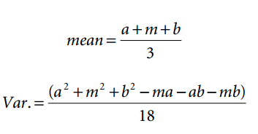
Triangular Distribution
where
a = minimum value
m = most common value (the mode)
b = maximum value

Slide 15
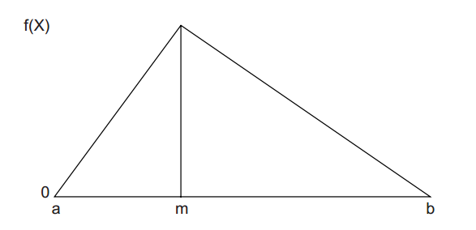
Triangular Distribution

Slide 16
Triangular Distribution
Examples of uses of the triangular distribution include:
• Customer service times
• Travel times

Slide 17
Normal Distribution
The time duration for many service processes follows the normal distribution.
The reason for this is that many processes actually consist of a number of subprocesses.
Regardless of the probability distribution of each individual subprocess, when the subprocess times are added together, the resulting time durations frequently become normally distributed.
The normal distribution has two parameters: the mean and the standard deviation.

Slide 18
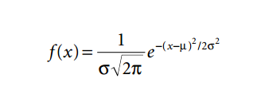
Normal Distribution
where µ is the mean and σ is the standard deviation. Figure 5.6illustrates the major features of the normal distribution.

Slide 19
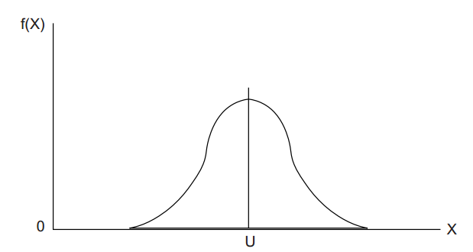
Normal Distribution

Slide 20
Normal Distribution
The empirical rule tells you what percentage of your data falls within a certain number of standard deviations from the mean:
• 68% of the data falls within one standard deviation of the mean.
• 95% of the data falls within two standard deviations of the mean.
• 99.7% of the data falls within three standard deviations of the mean.

Slide 21
Chi-Square Goodness of Fit Test
Chi-square test is based on the comparison of the actual number of observations versus the expected number of observations.
The steps in executing the chi-square test are as follow:
• Establish null and alternative hypotheses
• Determine a level of test significance
• Calculate the critical value from the chi-square distribution
• Calculate the chi-square test statistic from the data
• Compare the test statistic with the critical value
• Accept or reject the null hypothesis

Slide 22
Hypotheses Statements
The null hypothesis will generally be a statement to the effect that the input data could have come from a particular theoretical distribution.
Similarly, the alternate hypothesis is a statement that the input data could not have come from a particular theoretical distribution.
In practice, the null and alternative
hypotheses statements are condensed into the following format:
Ho : Distribution (parameter 1, parameter 2, …)
Ha : Not distribution (parameter 1, parameter 2, …)

Slide 23
Hypotheses Statements
For example, if we thought that the theoretical distribution was normal with a mean of 5 and a standard deviation of 2, the hypotheses statement would appear as:
Ho : Normal (5, 2)
Ha : Not normal (5, 2)

Slide 24
Determine a Level of Test Significance
It is necessary to establish a confidence level for the test.
For example, if you want to be 95% confident of your test results, the level of significance is 0.05.
The level of significance is often referred to as the α level.
Other common αlevels are 0.01 and 0.10.

Slide 25
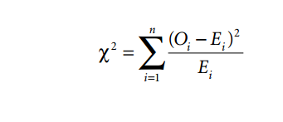
Calculate the Chi-Square Test Statistic from the Data
The test statistic is calculated by summing the squared differences between the observed number of data points and the expected number of data points divided by the expected number of data points for each individual data cell.
This process is more easily explained with the following formula:

Slide 26
Calculate the Chi-Square Test Statistic from the Data
Where:
χ 2 = test statistic to be calculated and compared to the critical value.
Oi = number of observations of data points in the ith data cell.
Ei = number of expected data points in the ith data cell.
n= number of data cells.

Slide 27
Accept or Reject the Null Hypotheses
If it turns out that the test statistic is less than the critical value, then the null hypothesis that the data could have come from that theoretical distribution cannot be rejected at the previously determined level of significance.
Conversely, if the test statistic value is greater than the critical value, then the null hypothesis is rejected.
That would mean that there is evidence that the data did not come from that theoretical distribution.

Slide 28
Kolmogorov–Smirnov
The KS test should be utilized only when the number of data points is extremely limited and the chisquare test cannot be properly applied.
The concept behind the KS test is a comparison between th cumulative theoretical distribution and the cumulative observed distribution.
If the maximum difference between the cumulative theoretical and observed distribution exceeds a critical KS value, then the observed distribution could not have come from the theoretical distribution.

Slide 29
Kolmogorov–Smirnov
The steps for the KS are:
• Establish null and alternative hypotheses
• Determine a level of test significance
• Determine the critical ks value from the dtable
•Determine the greatest absolute difference between the two cumulative distributions
• Compare the difference with the critical ks value
• Accept or reject the null hypothesis

Slide 30
Summary
Any Questions?

